Slide 1
Petrography and Diagenesis of the Neogene Surma Group from the Begumganj Structure, Bengal Basin: Implications for Provenance and Reservoir Quality
Presented By:
Padmasree Paul
Examination Roll: 220493 Registration No: 48119 Session: 2021-2022
Research Supervisor:
Dr. M. JullehJalalur Rahman
Professor
Department of Geological Sciences Jahangirnagar University Savar, Dhaka-1342
Research Co-Supervisor:
Dr. Abu Sadat Md. Sayem
Professor
Department of Geological Sciences Jahangirnagar University Savar, Dhaka-1342

Slide 2
Outlines
Background & Significance
Location of the study area
Aims & Objectives
Research Methodology
Results & Discussion
Facies Analysis
Petrographic Characteristics of Sandstone
Clay Mineralogy
Diagenesis & Reservoir Quality
Summary & Conclusions

Slide 3
Background & Significance
The Bengal Basin in Southeast Asia, covering much of Bangladesh, is a prolific hydrocarbon-bearing sedimentary basin.
Most of Bangladesh's gas production comes from onshore fields, with additional being drilled in offshore locations.
From the sedimentological point of view, little attention has been given to the Hatiya Trough compared to Sylhet Trough.
Analyzing the petrographical and diagenetic controls on the Neogene Surma Group may provide valuable insights on predicting provenance and reservoir quality within the Hatiya Trough, Bangladesh.

Slide 4
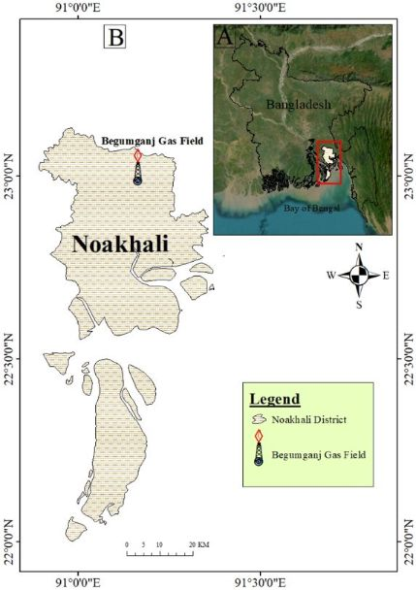
Study Area
The Begumganj gas field located to the west of Feni in the Noakhali district.
Tectonically located at the intersection of the Hatia Trough and the Barisal-Chandpur Gravity High.

Slide 5
Aims & Objectives
To delineate lithofacies and depositional environmentof Neogene Surma Group,
To characterize the petrographic properties of Surma Group sandstones,
To elucidate the clay mineral compositionsofSurma Group shales,
To reveal the diagenetic factors affecting reservoir quality of this area, and
Finally, to infer the provenanceandreservoir quality of Surma Group sediments.

Slide 6
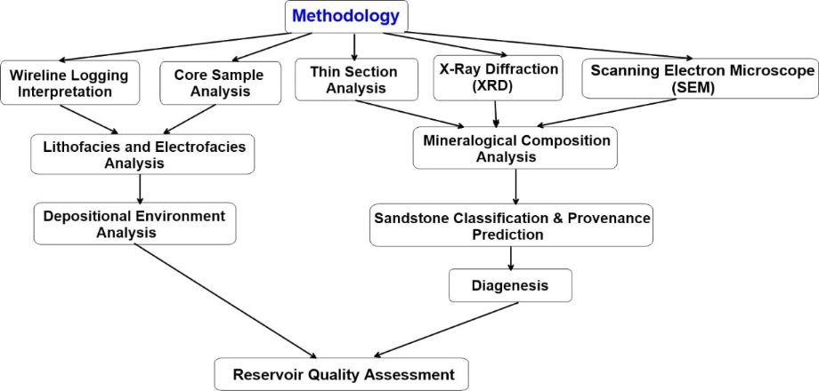
Research Methodology

Slide 7
Results and Discussion

Slide 8
Facies Analysis
Gross Lithology of the Begumganj Well-3 (BAPEX report, 2014)
Core 1
Core 2
Depth (m) | Lithology
2891 | Mainly Shale (~60%) with Sandstone (~40%)
2891.5 | Sandy Shale
2892-96 | Mainly Sandstone (~60%) with Shale (~40%)
Depth (m) | Lithology
3178.5 | Mainly Sandstone (~90%) with Shale (~10%)
3182.5-3186 (top) | Sandstone 70%; Shale 30%
3186 (bottom) | Sandstone 60%; Shale 40%

Slide 9
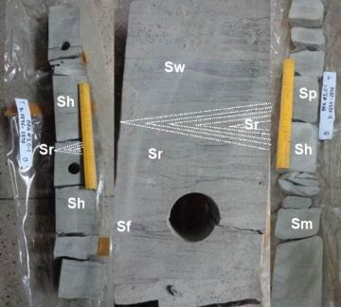
Facies Analysis
Core Lithofacies Analysis
Ripple Cross-laminated sandstone (Sr)
Wavy-bedded sandstone (Sw)
Flaser-bedded sandstone (Sf)
Parallel-bedded sandstone (Sh)
Massive sandstone (Sm)
Planar cross-bedded sandstone (Sp)

Slide 10
Facies Analysis
Shale dominated facies
At depths of 2810 to 3140 meters they are mostly present. They are likely develop in a tranquil depositional setting with minimal hydrodynamic energy.
Alternating sandstone and shale facies
The identified wavy-bedded facies (Sw) deposited under moderate to low energy conditions in the middle portion of the intertidal zone.
Sandstone dominated facies
The flaser-bedded sandstone (Sf), parallel-bedded sandstone (Sh), planar cross-bedded sandstone (Sp), and massive sandstone facies (Sm) indicate deposition in environments ranging from lower intertidal to the upper subtidal zone with high-energy conditions, including upper flow regime in shallow tidal channels and strong tidal currents within broad subtidal settings.

Slide 11
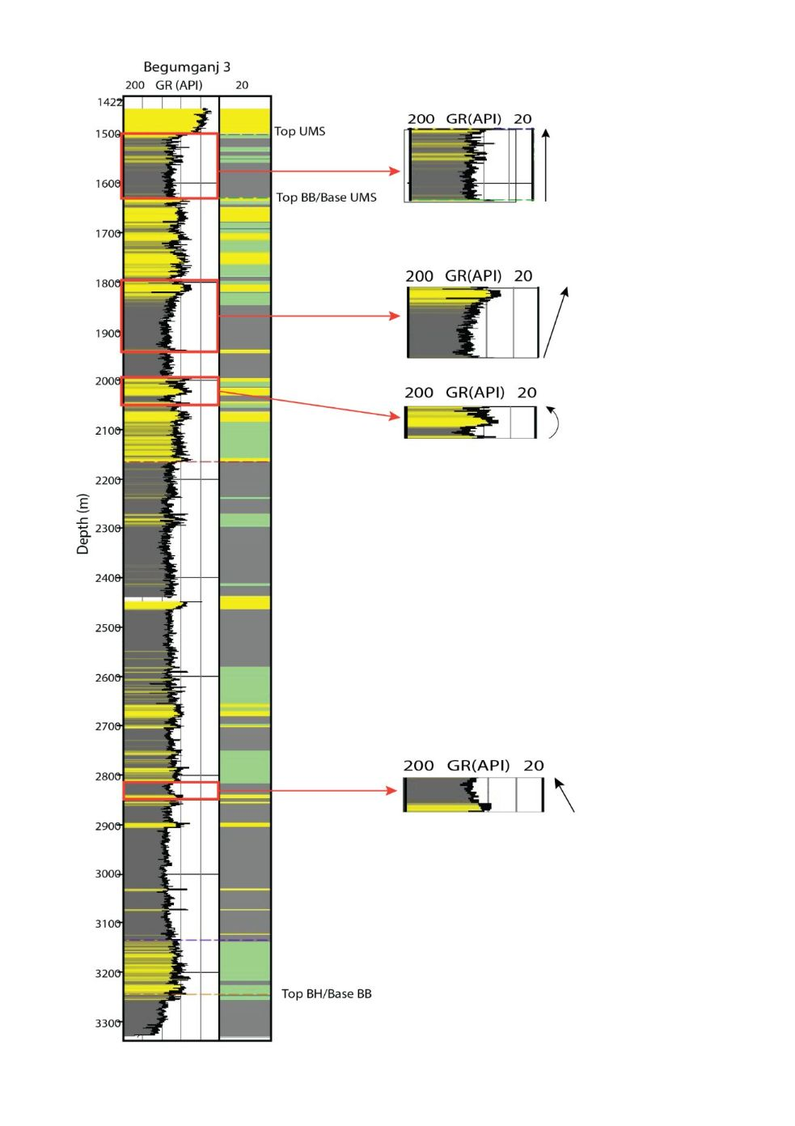
Facies Analysis
Electrofacies Analysis
4 types of electrofacies identified:
Cylindrical Pattern (Box-car)
Fining Upward Pattern (Bell Shape)
Coarsening Upward Pattern (Funnel Shape)
Symmetrical pattern (Bow Shape)

Slide 12
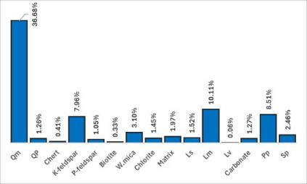
Petrographic Characteristics of Sandstone
Constituents of Sandstones
Relative abundance of constituents (average) of the Neogene sandstones of Begumganj well-3

Slide 13
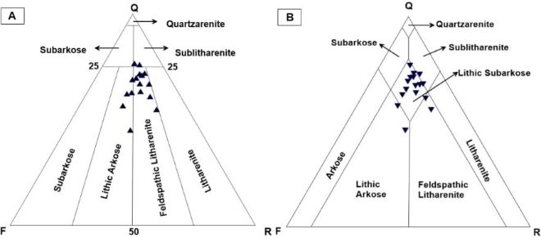
Petrographic Characteristics of Sandstone
Sandstone Classification

Slide 14
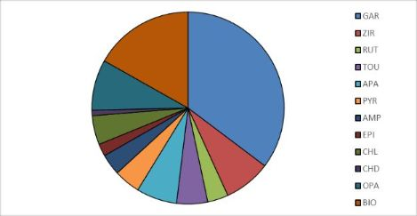
Petrographic Characteristics of Sandstone
Heavy Mineral Assemblages
Average heavy mineral composition encountered in Brgumganj well-3

Slide 15
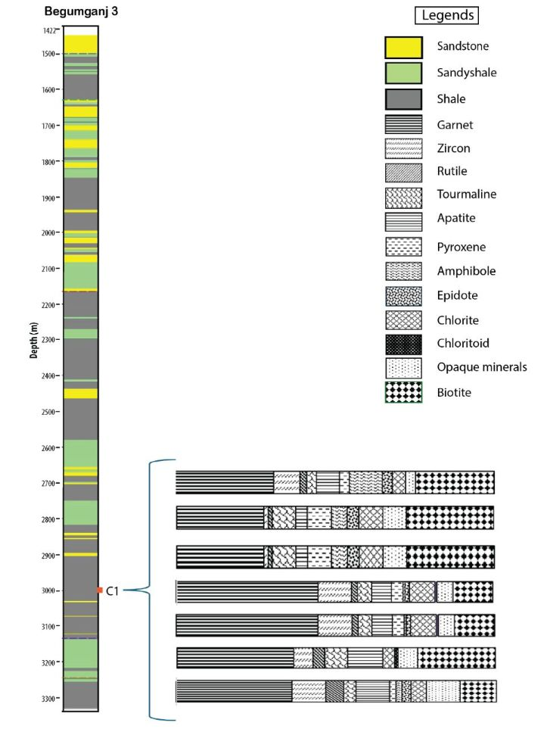
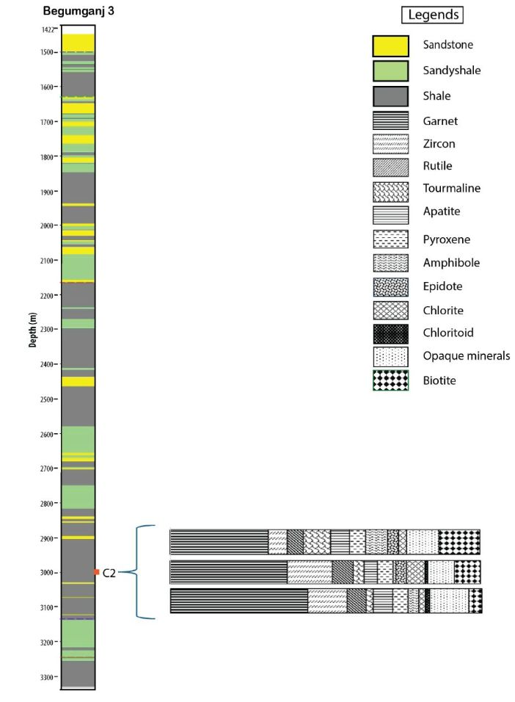
Trends in Heavy Mineral Distribution
Core 1
Core 2

Slide 16
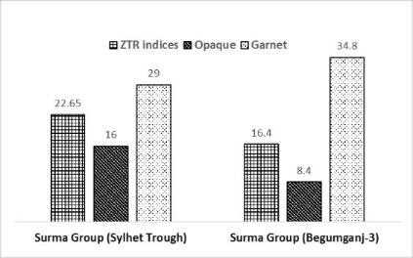
Total ZTR indices, Opaque minerals and Garnet content
Comparison of total ZTR indices, Opaque minerals and Garnet content in Surma group of Sylhet trough vs Begumganj well-3

Slide 17
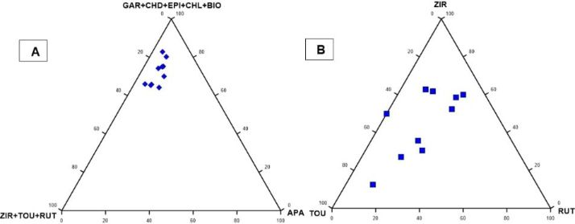
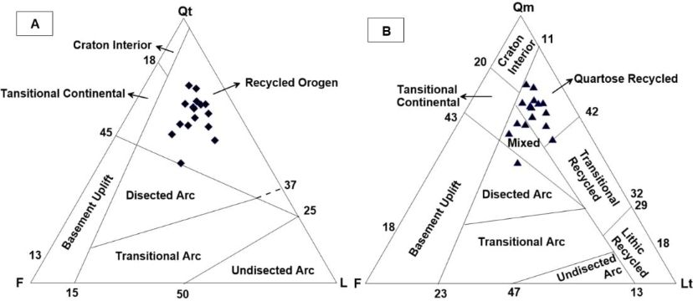
Petrographic Characteristics of Sandstone
Provenance

Slide 18
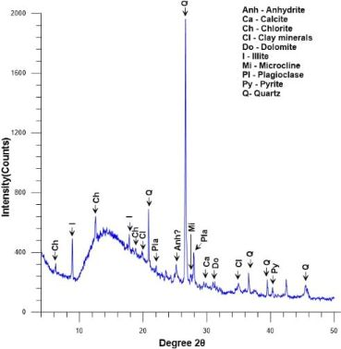
Clay Mineralogy
Bulk minerals
Quartz ( 42.1%)
Microcline ( 2.3%)
Plagioclase ( 8.9%)
Calcite ( 2.4%)
Dolomite ( 2.0%)
Pyrite ( 3.6%)
Clay minerals ( 38.7%)
X-ray diffraction pattern of bulk fraction of shale from 3182 m depth of Begumganj well-3

Slide 19
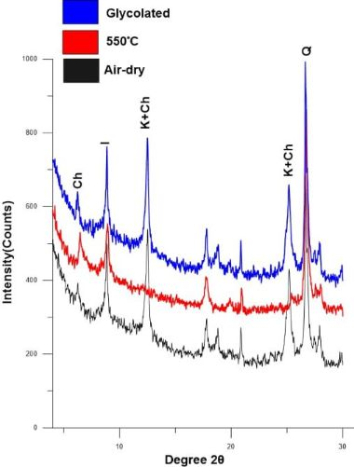
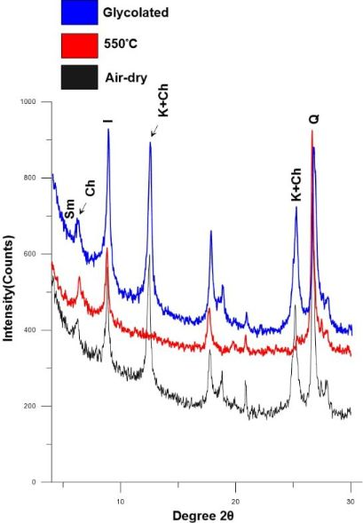
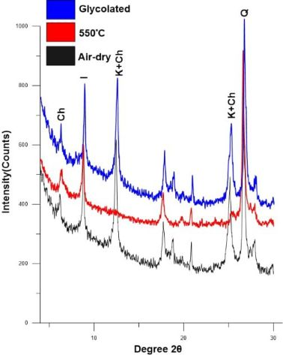
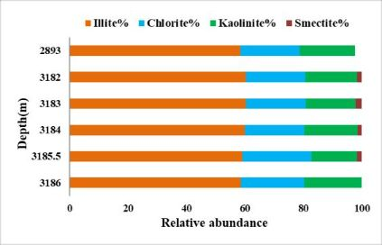
Clay Mineralogy
Clay minerals
Illite (59.4%)
Chlorite (21.3%)
Kaolinite (17.8%)
Smectite (1.2%)

Slide 20
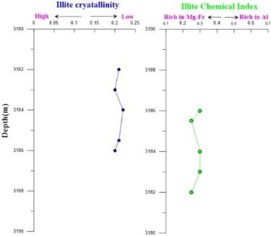
Clay Mineralogy
Illite crystallinity varies from0.17°Δ2θ- 0.22°Δ2θ (avg. 0.20°Δ2θ) indicates excellent crystallization
Illite chemical index (CI) ranges from 0.25 to 0.40 (avg. 0.30) indicates Fe-Mg-rich illite
Both values suggest dry and cool environments with intense physical weathering

Slide 21
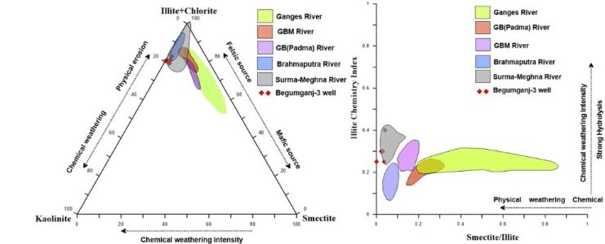
Clay Mineralogy
Origin of clay minerals

Slide 22
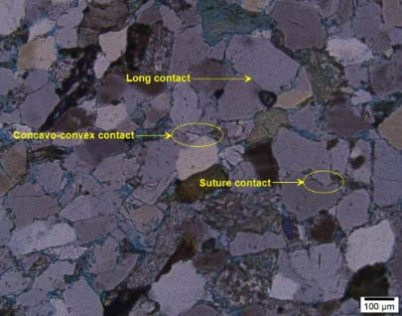
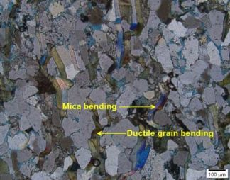
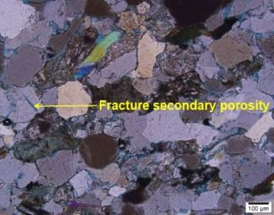
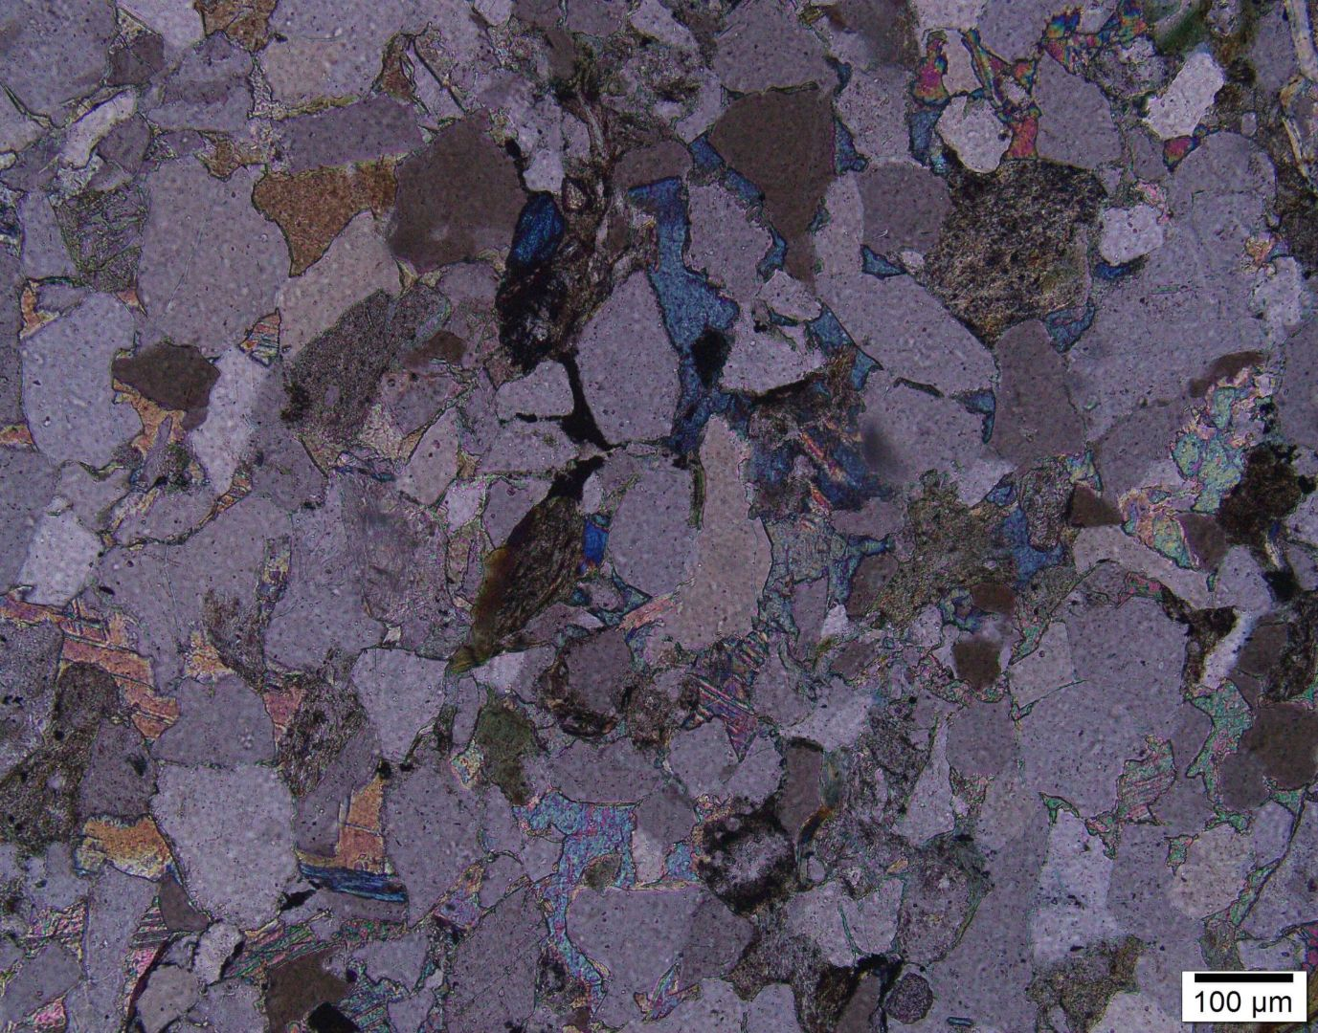
Diagenesis & Reservoir Quality
Compaction

Slide 23
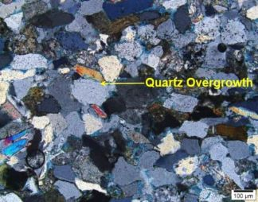
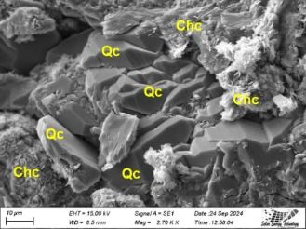
Cementation (Quartz Overgrowth)
Diagenesis & Reservoir Quality
Photomicrographshowingquartz overgrowth and SEM image showing quartz overgrowth (Qc) that hindering the growth of chlorite cement (Chc)

Slide 24
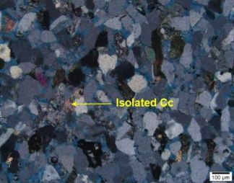
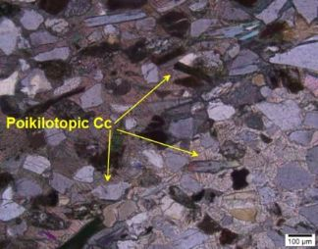
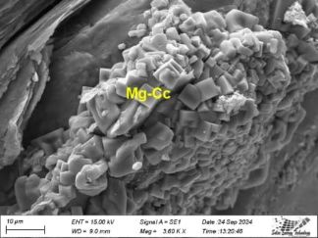
Cementation (Carbonate Cement)
Diagenesis & Reservoir Quality

Slide 25
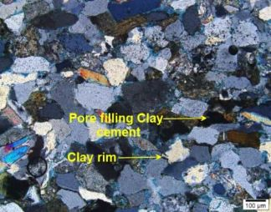
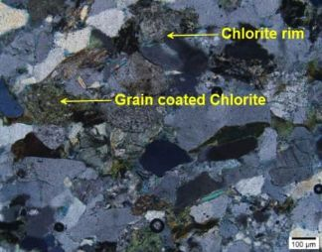
Diagenesis & Reservoir Quality
Cementation
(Clay Cement and
Authigenic Chlorite)
Clay cement (avg. 9.4%) is the most common cement in the Begumganj well-3 among which, authigenic chlorite is 1.45% and occurs as pore-filling, grain coating, replacement of micas

Slide 26
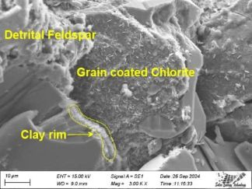
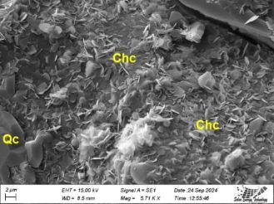
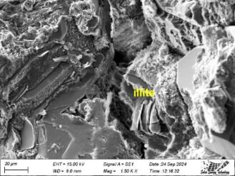
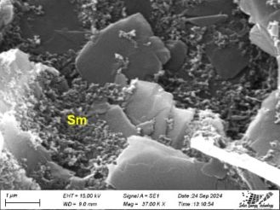
SEM images showing different types of Clay minerals at different depths

Slide 27
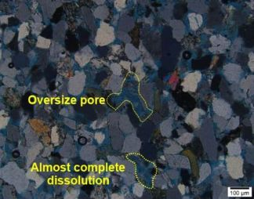
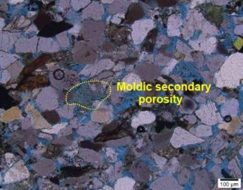
Dissolution
Diagenesis & Reservoir Quality
Secondary porosities such as partial dissolution, oversized pores , moldic pores, honeycomb pores have been observed in the studied samples as a result of dissolution.
Primary porosity constitute avg. 8.51% which is much higher than the Secondary porosity of the total porosity.

Slide 28
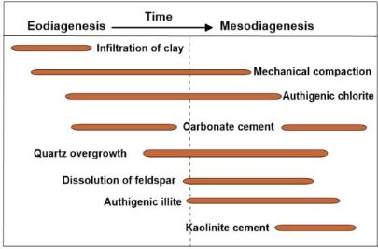
Paragenetic sequence
Diagenesis & Reservoir Quality
Paragenetic sequence of diagenetic features observed in the Neogene sandstones, Begumganjwell-3

Slide 29
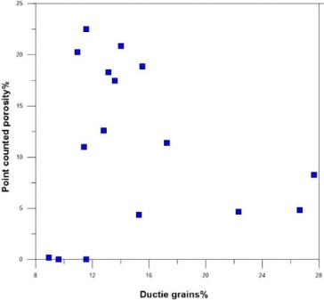
Diagenesis & Reservoir Quality
Depositional Controls
Relationbetweenpoint-counted porosity (%) vs. ductile grains (%)

Slide 30
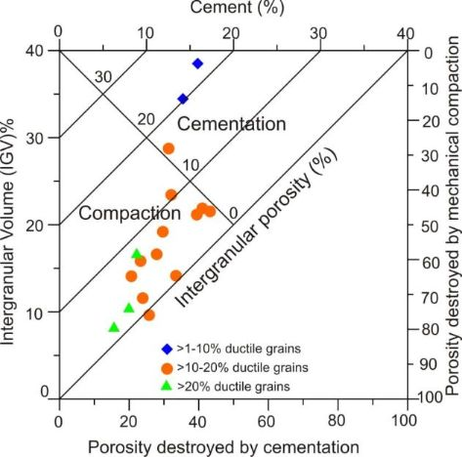
Diagenesis & Reservoir Quality
Diagenetic Controls
Plot of intergranular volume (IGV) versus cement of the Neogene sandstone in the Begumganj well-3 after Houseknecht (1987)

Slide 31
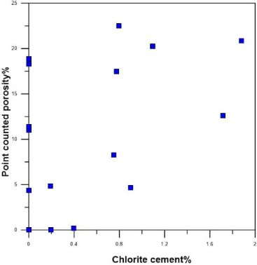
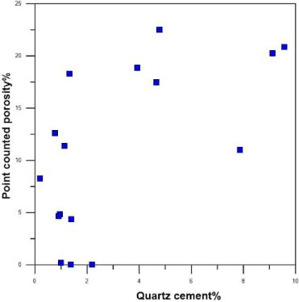
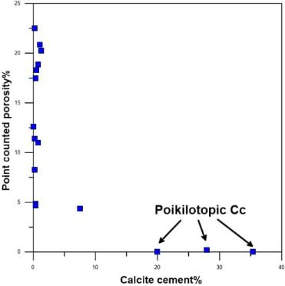
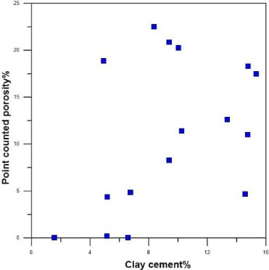
Diagenetic Controls

Slide 32
Summary & Conclusions
The Begumganj Gas Field developed in a shallow marine shelf andtide-dominated delta system.
The sandstones from Begumganj Gas Field are Lithic subarkose to Feldspathic litharenitein nature and sourced from predominantly “Recycled orogen” provenance. The Himalayan Mountain ranges along with Indo-Burman Ranges played a significant role as the primary source of these recycled sediments.
Heavy mineral assemblages suggests Neogene sandstones are probably derived fromlow to medium grade metamorphic rocks.
Illite crystallinity and chemical index values suggests that Neogene shales were deposited in dry and cool environmental with prevalence of physical weathering and they are input from theSurma-Meghna and Brahmaputra River systems.

Slide 33
Summary & Conclusions
Based on core analysis, good porosities at depth of 2890-2897m ranging from 10 to 17% ( avg. 15%) and permeabilities 12 mD-207 mD (avg. 69 mD) has been observed. On the other hand, at depth 3178-3186m moderate porosities and permeabilities with an avg. 6.43% and 4 mD has been found.
So, the overall reservoir sandstone from Begumganj Gas Field indicates moderate average porosity (primary + secondary =11%) and permeability values. The porosity reduction in the Neogene Sandstone was caused primarily by mechanical and ductile grain compaction followed by clay cementation and poikilotopic carbonate cementation (locally).
Finally, it can be concluded that the Neogene Surma Group from the Begumganj Gas Field has moderate reservoir quality.

Slide 34



Acknowledgements
Dr. M. JullehJalalur Rahman
Professor
Department of Geological Sciences
Jahangirnagar University
Dr. Abu Sadat Md. Sayem
Professor
Department of Geological Sciences
Jahangirnagar University
Farida Khanam
Manager (Geophysics)
BAPEX
National Science and Technology Fellowship
Bangladesh Petroleum Exploration and Production Company Limited
Wazed Miah Science Research Center, Jahangirnagar University

Slide 35
Thank You!
Any Questions?

